Slide 1
Fitness Buddy: AI-Powered VIRTUAL FITNESS TRAINER
CAPSTONE PROJECT
Presented By:
ROHIT KADAV– Terna Engineering College –
Computer Engineering

Slide 2
OUTLINE
Problem Statement
Technology Used
Wow Factors
Proposed System / End Users
System Development Approach
Algorithm & Deployment
Result (Output Image)
Conclusion
Future Scope
References
Links and Certifications

Slide 3
Problem Statement
In today's fast-paced and digitally driven world, maintaining a consistent and healthy lifestyle has become increasingly difficult. Many individuals face challenges such as:
Lack of personalized fitness guidance
Limited time for scheduled workouts
Inaccessibility to professional trainers or nutritionists
Inconsistent motivation to stay on track with wellness goals
Traditional fitness programs often require costly subscriptions, rigid schedules, or in-person consultations, which are not always feasible for everyone.

Slide 4
Technology used
IBM cloud lite services
IBM Granite model
IBM Cloud Watsonx AI Studio
IBM Cloud Watsonx AI runtime
IBM Cloud Agent Lab
IBM Cloud Watsonx AI Assitant

Slide 5
Wow factors
Conversational Experience over WhatsApp
Real-Time, Personalized Responses Fitness, motivation, and nutrition tips are tailored instantly based on user input and intent. Powered by IBM Watson + Granite
Combines IBM’s cutting-edge NLP and generative AI to simulate human-like conversations.
Fully Cloud-Based & Serverless
Hosted using IBM Cloud Lite with optional backend integration — no heavy infrastructure needed.
New features like reminders, workout logging, or wearable sync can be added without redesigning the core.
Anyone with WhatsApp access can use the chatbot instantly — increasing accessibility.
Solves a Real Problem with AI for Good
Tackles health, motivation, and consistency — improving lives using smart technology.

Slide 6
End users
Gym Trainers
Students
Busy Professionals
Home-Based Fitness Enthusiasts
Beginners or Older Adults
People in Remote or Rural Areas

Slide 7
Proposed Solution
Fitness Buddy is a conversational, AI-powered virtual assistant designed to help individuals lead healthier lifestyles with ease and consistency. The chatbot offers:
Personalized home workout recommendations based on user input
Motivational tips and daily wellness inspiration
Suggestions for simple, nutritious meals
Support for habit-building and fitness consistency
Built using IBM Watson Assistant and optionally integrated with IBM Granite AI models, Fitness Buddy provides an intelligent, accessible, and user-friendly experience through platforms like WhatsApp via Twilio.

Slide 8
System Approach
The Fitness Buddy system is designed as a modular, cloud-based conversational assistant that delivers fitness-related guidance through chat platforms like WhatsApp. It follows a structured flow with the following components:
1. User Interaction Layer:
Users communicate via WhatsApp using the Twilio Sandbox. Messages are forwarded to IBM Watson Assistant for processing.
2. Watson Assistant (Core Engine):
Handles natural language understanding (NLU) and manages conversation flow through predefined Intents and Actions. Triggers context-aware responses for workouts, meals, habits, or motivation.
3. Backend Integration:
For dynamic responses, Watson can trigger webhooks calling a backend server. The backend can use IBM Granite models via Watsonx API to generate personalized advice.
4. Response Delivery:
Watson sends the reply back through Twilio.The user receives a real-time, friendly message on WhatsApp.

Slide 9
Algorithm & Deployment
User initiates a message on WhatsApp (e.g., "Give me a workout").
Twilio Sandbox forwards the message to IBM Watson Assistant.
Watson Assistant matches the input to a predefined intent using NLP.
Based on the matched intent, the corresponding action is triggered.
The action responds in one of two ways:
The final response is sent back to the user via Twilio.
Frontend Channel: WhatsApp via Twilio Sandbox
Core Engine: IBM Watson Assistant (Lite Plan)
Optional Backend: Node.js Express server for API integration with IBM Granite
Watson Assistant hosted on IBM Cloud
Twilio handles message routing

Slide 10
Result
The Fitness Buddy AI chatbot was successfully developed and integrated using IBM Watson Assistant and Twilio WhatsApp, enabling users to:
Interact with a virtual fitness assistant via WhatsApp in real-time
Receive personalized home workout routines on request
Get motivational tips and wellness encouragement
Explore simple, nutritious meal suggestions
Build healthy fitness habits through daily advice
The system demonstrated high usability, fast response times, and intuitive conversational flow.
It meets the goal of providing accessible, intelligent fitness support anytime, anywhere — without requiring any hardware, subscription, or app installation.

Slide 11
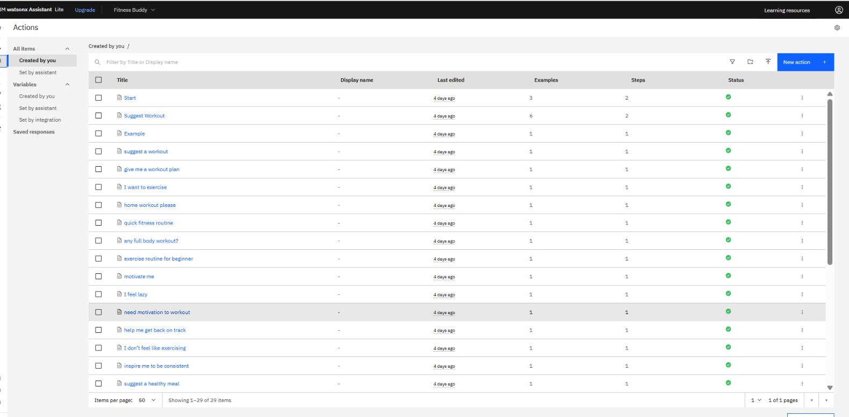

Slide 12
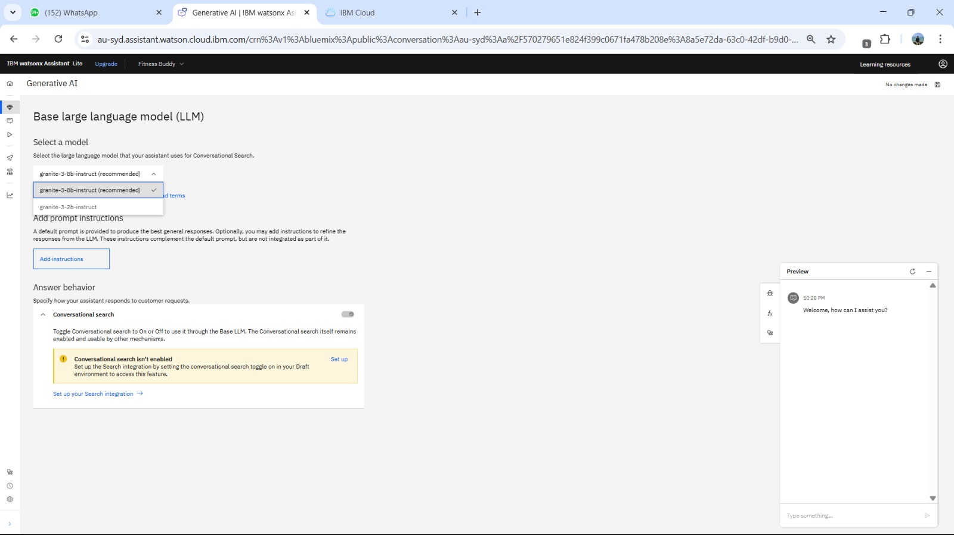

Slide 13
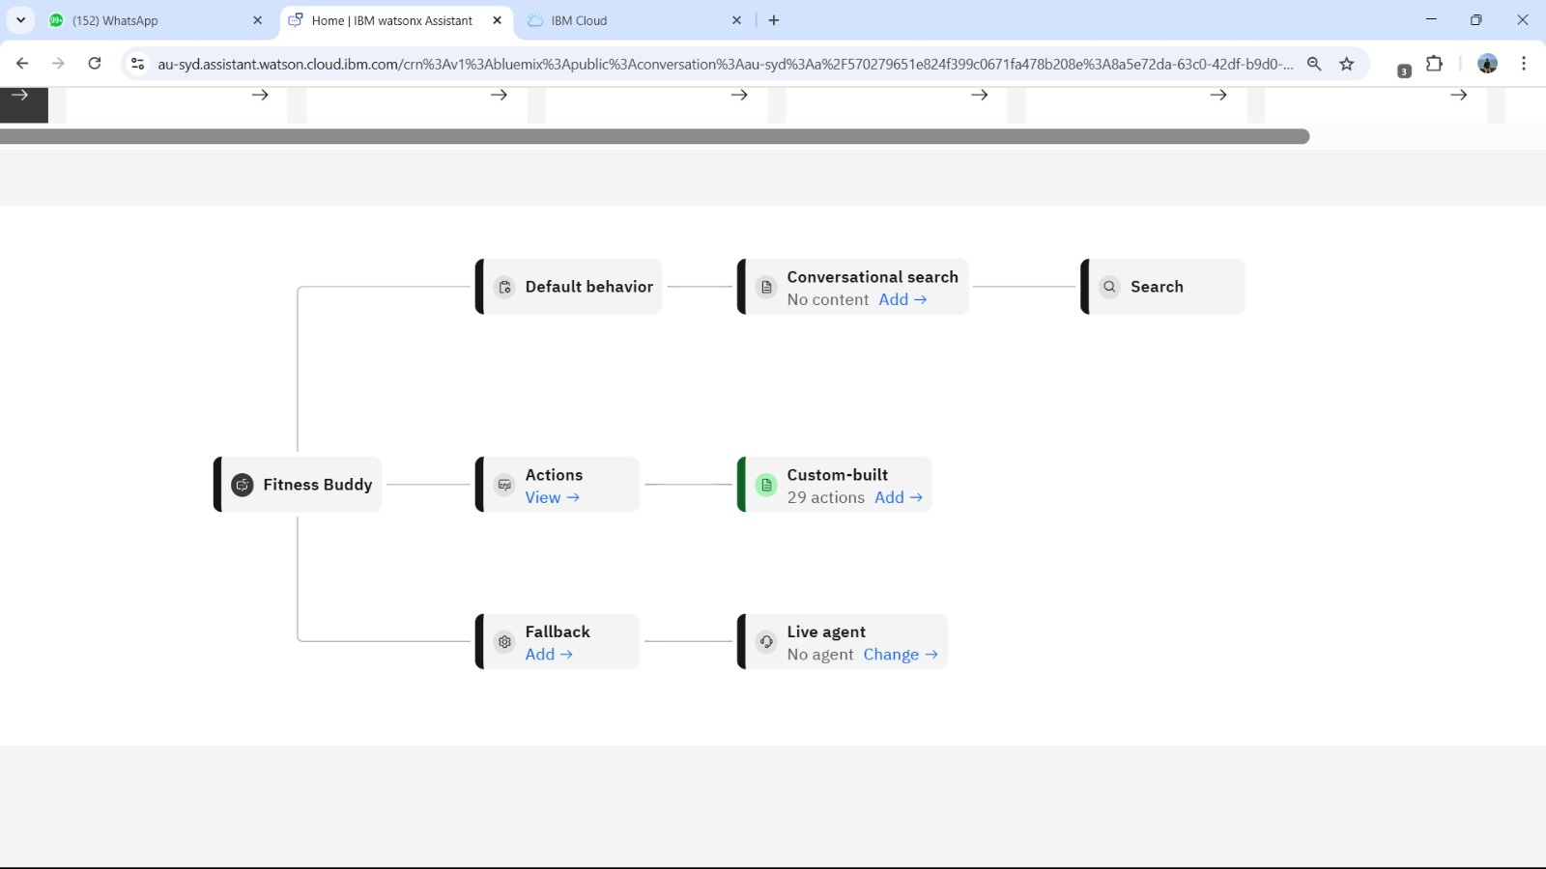

Slide 14
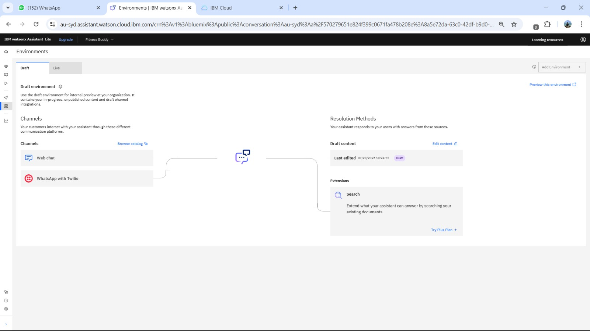

Slide 15
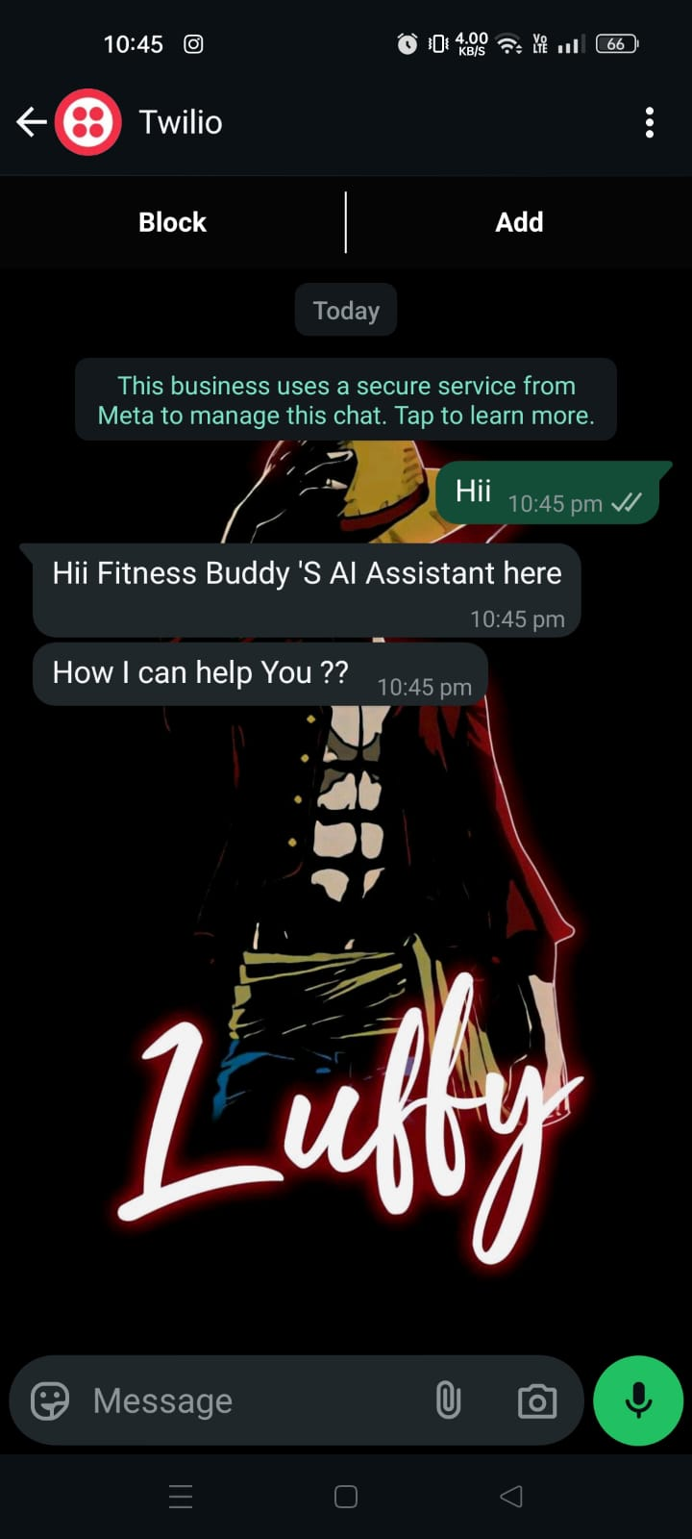
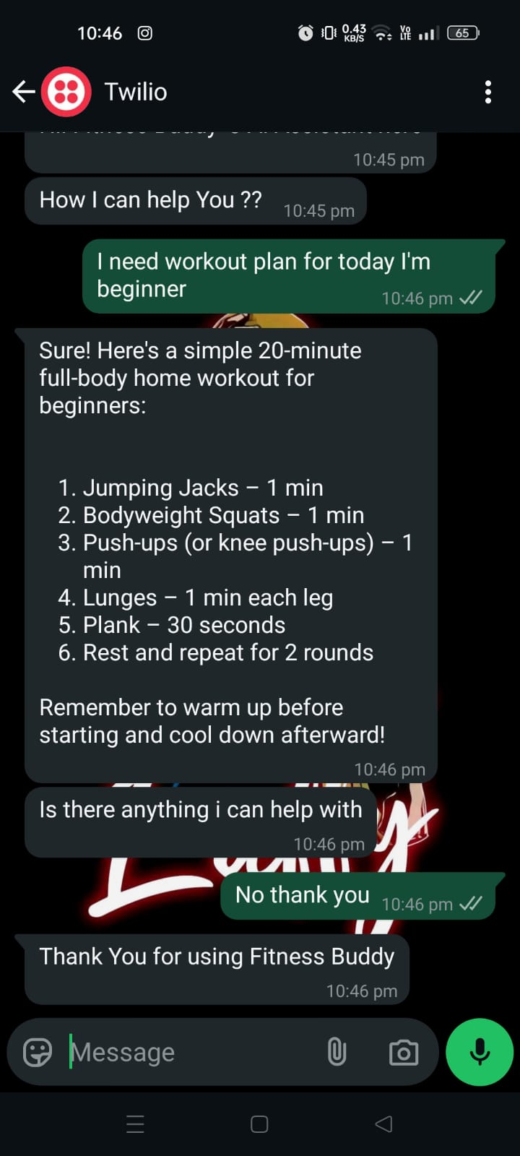
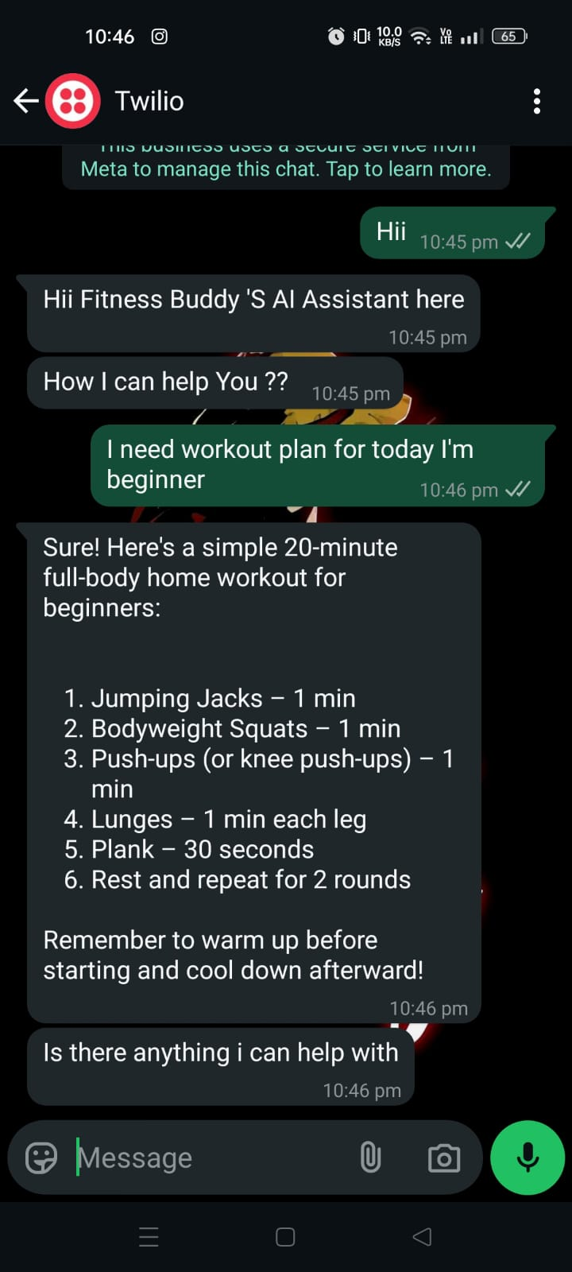

Slide 16
Conclusion
Fitness Buddy demonstrates how AI-powered conversational systems can make fitness support more accessible, personalized, and engaging.
By leveraging IBM Watson Assistant, IBM Cloud, and Twilio WhatsApp, the solution enables users to:
Receive on-demand health and fitness advice
Stay motivated with daily inspiration
Adopt sustainable healthy habits
The project solves real-world problems like time constraints, lack of guidance, and motivation gaps — using AI for good.

Slide 17
Future scope
The Fitness Buddy chatbot can be enhanced in multiple ways to improve user experience, intelligence, and scalability:
AI-Driven Personalization : Integrate IBM Granite models or external ML APIs to deliver personalized workouts, meal plans, and motivation based on user history and preferences.
Health Tracking Integration: Connect with wearable devices or health apps (e.g., Google Fit, Apple Health) to monitor real-time data like steps, sleep, or heart rate.
Multilingual Support : Enable the chatbot to support multiple languages for broader accessibility across different regions and demographics.
Calendar & Reminder System : Add scheduling features to remind users about workouts, hydration, or meals with WhatsApp reminders.
AI Sentiment Detection : Detect user mood or tone and adapt motivational responses dynamically using natural language understanding.
Mobile App Integration: Embed the chatbot within a mobile app for a more immersive and feature-rich experience.

Slide 18
References
IBM Watson Assistant
https://www.ibm.com/cloud/watson-assistant
Used for creating the conversational AI chatbot and managing intents/actions.
IBM Cloud (Lite Plan)
https://cloud.ibm.com
Platform for hosting Watson services and managing integrations.
IBM Granite Foundation Models (Watsonx)
https://www.ibm.com/products/watsonx
Used optionally for AI-generated dynamic responses via API.
Twilio WhatsApp Sandbox
https://www.twilio.com/whatsapp
Used for WhatsApp integration and chatbot deployment.
Node.js & Express.js (Optional)
Backend server setup to handle API calls for dynamic response generation.
IBM Watsonx.ai API Docs
https://cloud.ibm.com/apidocs/watsonx-ai
Documentation for integrating Granite models programmatically.

Slide 19
Github link
https://github.com/rohitkadav/IBM-Internship-Project

Slide 20
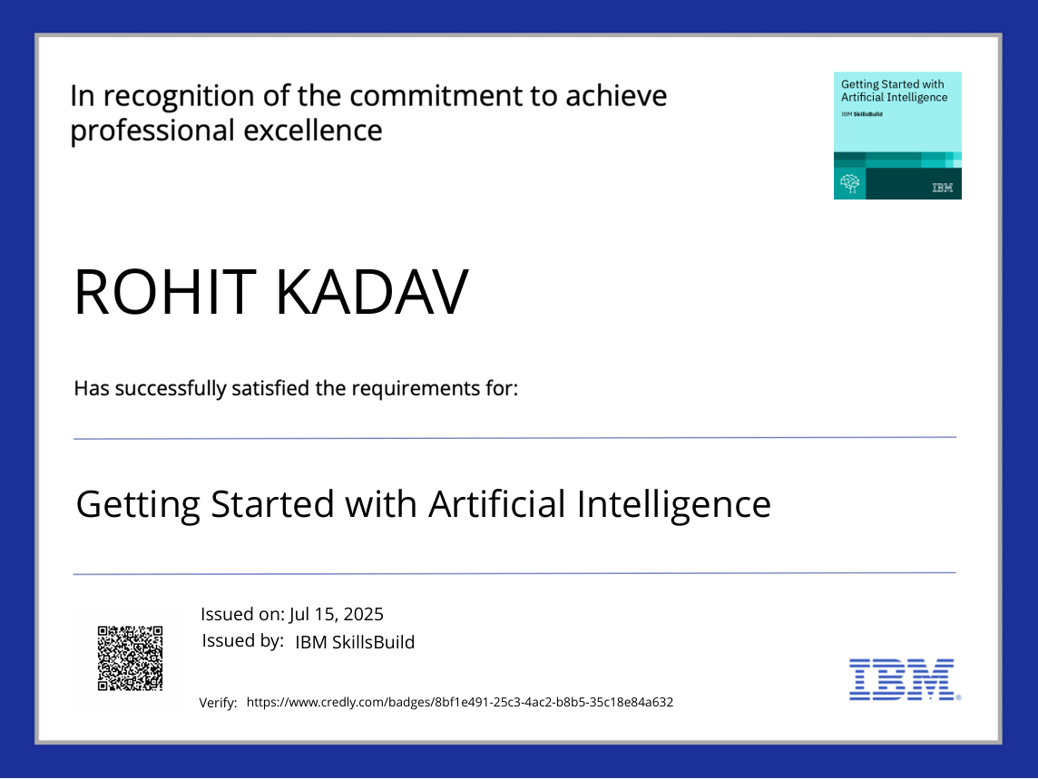
IBM Certifications

Slide 21
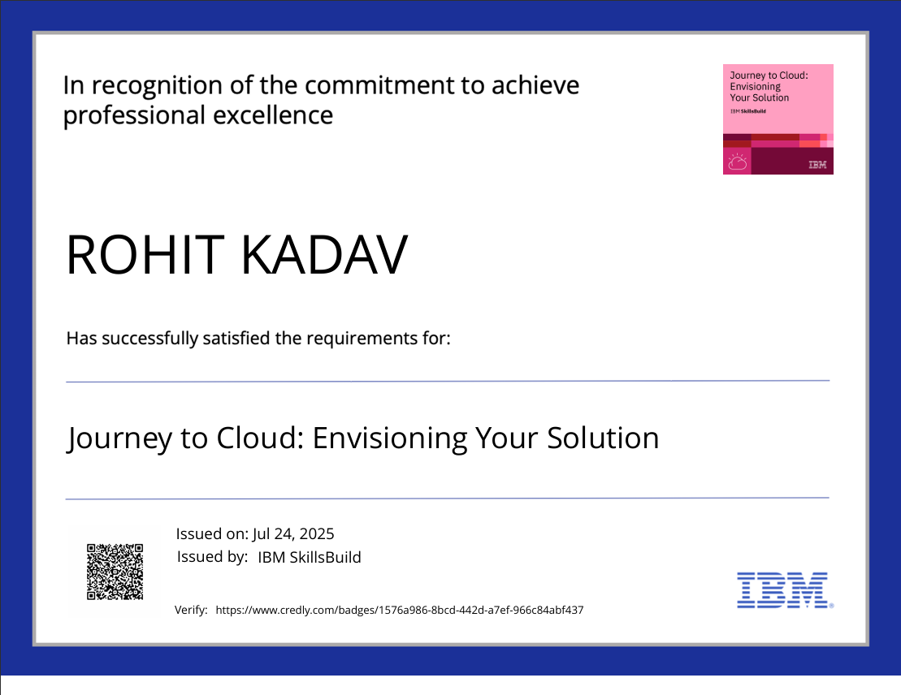
IBM Certifications

Slide 22
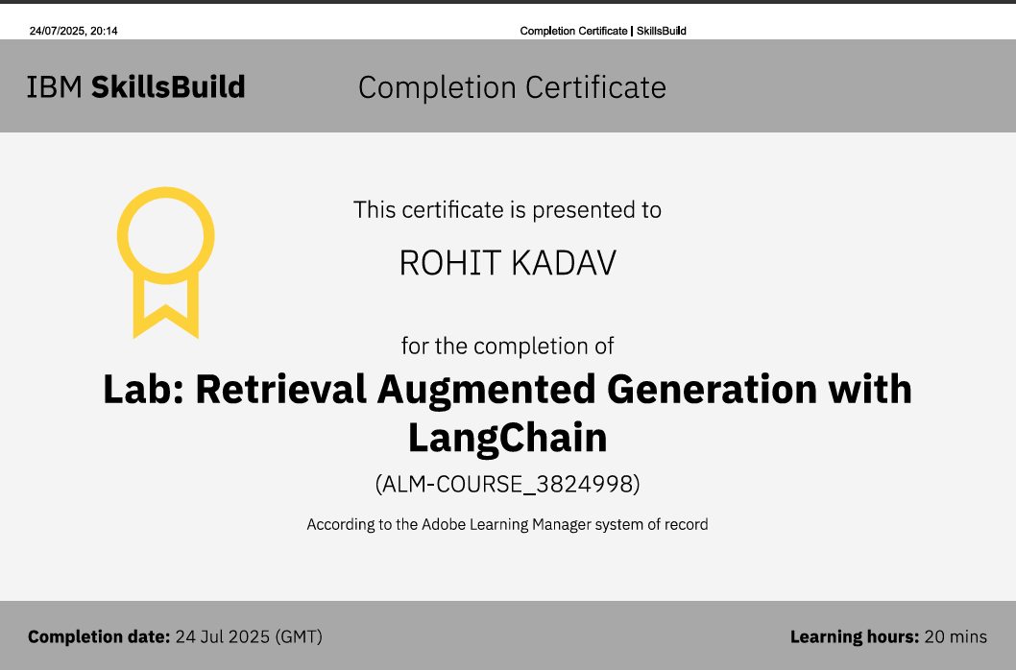
IBM Certifications

Slide 23
THANK YOU

